Slide 1
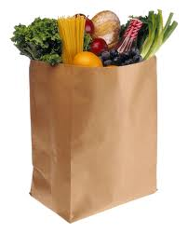
Eating Healthy on a Budget
Heidi Roth, RD, LDN, CHHC

Slide 2
Pandemic Challenges
Infrequent rushed shopping
Potential shortages
Stress Eating

Slide 3
Agenda
What is Healthy Eating
Planning
Shopping Tips
Food Safety

Slide 5
This……

Slide 6
Not that!
S.A.D (Standard American Diet)
Notes:
Pay for this twice

Slide 7
But a lot of THIS is expensive….

Slide 8
5 Principles Healthier Eating on a Budget
Forgo processed foods
Eat less meat
Most expensive part of meal
Add more plant-based protein
Eat seasonally
Don’t waste
Plan and Prep

Slide 9
Planning – The key to saving TIME and MONEY!
Know what’s on your shelf
Plan meals and snacks before you go shopping
Make a list – avoid overbuying
Coupons?
Watch out!
Check flyers for weekly specials

Slide 10
Pantry Staples - Delivered
Amazon Fresh, Peapod, etc. seem like they are at capacity
How can I spend less time at the grocery store?
Mercato
Boston-based specialty foods delivery
Thrive Market
Membership-based online grocery delivery
Target, Walmart
Shipping dry goods through package delivery services

Slide 11
Eating Fruits and Vegetables
Buy bagged apples, oranges, potatoes, grapefruit, onions
Buy in season
Frozen are just as nutritious
Cook some veggies in advance
Avoid bagged lettuce, shredded cabbage, precut fruits and vegetables

Slide 12
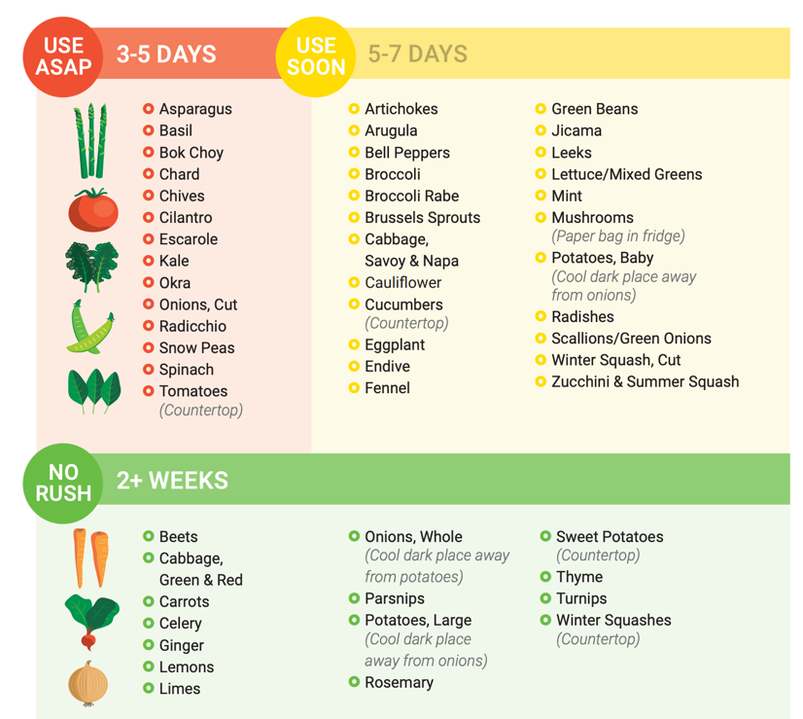
Credit:
Cooksmarts.com

Slide 13
Greens!
$.040 – $0.75 per serving

Slide 14
Over-the-Hill Greens
Depending on how far gone, soak them in cold water and spin dry
Roast them
Saute to top bruschetta and potatoes
Freeze in a freezer to add to soups, casseroles and smoothies

Slide 15
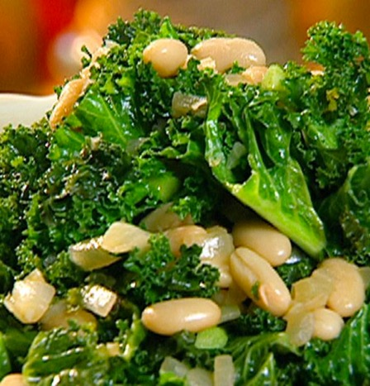
And Beans!
Beans and Greens, Beans and Greens….
Best “bang for your buck”
High in protein, amazing for gut microbiome
Don’t need to soak:
Instant Pot
Lentils
Canned Ok too

Slide 16
Whole Grains
Oatmeal is nutritious and inexpensive
Buy in bulk (cereals, grains, beans, nuts)
Learn how to cook whole grains
All cook basically the same way, like rice
Freeze beautifully
Quinoa for a lighter texture, barley for meatier texture
$0.17 per serving

Slide 17
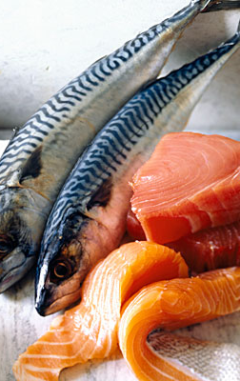
Fish – Budget Friendly options
Get to know and love SARDINES!
Buy frozen
Buy pieces instead of filet
Consider farmed vs wild salmon?!!
Still high in Omega 3s and astaxanthin
Most salmon sold in restaurants is farmed
Notes:
Studies done with people eating farmed salmon showed improved cardiovascular biomarkers and

Slide 18
Pantry Proteins
Beans, dried and canned
Any soups! Hummus, salads, curries, chilis, stews
Lentils
Tinned mackerel, tuna, sardines, oysters, clams, trout

Slide 19
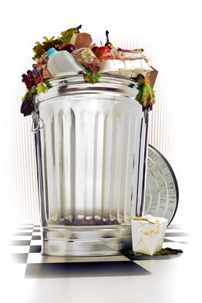
Leftovers – Tasty or Trash?
According to the WSJ, we spend $500- $2000 on food we never eat
Most of it is vegetables
Second-largest component of landfills

Slide 20
Smart Storing – Refrigerator
Create an “eat first” area
Store leftovers in pretty glass containers
Keep infrequently used oils and nuts in the fridge
Most “best-by” dates refer to food’s quality, not safety! If it looks and smells fine, most likely fine.
Exceptions: deli meats, fish, ground meat and prepared foods

Slide 21
Dairy
Shred cheese yourself
Cheese can be frozen
Buy large containers of plain yogurt, add fruit yourself
Look for freshest expiration date
Always keep cold, don’t keep in the door
Use older milk to bake with -

Slide 22
Expiration Dates, according to USDA
“Sell-by” and “Use-by” Dates
Milk
Good up to 5-7 days past Sell-by date
KEEP IT COLD!
Canned foods
Up to 5 years
Chicken and ground meat
1 to 2 days after purchase
Eggs, surprisingly long shelf life
Properly handled, still good for 5 weeks AFTER sell-by date
Notes:
FDA requires dates only on infant formula
For freshness, not food safety
Determined by the manufacturer

Slide 23
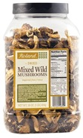
Make your Own Foolproof Soup
Saute piece of bacon, ham or sausage (optional)
Fry up a mixture of onions, celery, carrots, adding garlic last minute
Add broth or water and a little bouillon
Add veggies and cooked beans – clean out the fridge!
Add spices
Add umami
Simmer until veggies are soft
Finish with some sort of acid, and taste for seasonings

Slide 24
Have Fun!
Use what you have on hand
Don’t be afraid to make substitutions
Do a Google search for ingredients
Make an effort to try new ingredients, spices and veggies.

