Slide 1
Experience Matters
When it comes to driving better health and curbing costs.
King Philip Regional School District
May 2, 2022

Slide 2
Today’s Agenda
Introductions
HPHC Plan Options for July 1, 2022
Current four medical plans offered – no plan changes
Employees ability to contribute to a Health Savings Account (HSA)
Overview of a Health Savings Account (HSA)
Overview of MyHealthMath
Overview of Dental /Vision – no plan changes
Overview Health and Wellness Programs

Slide 3
Now, one combined organization
Committed to:
Improving affordability
Increasing access to high-quality care
Enhancing the member experience
© 2021 Tufts Associated Health Plans, Inc. All Rights Reserved
Notes:
Date: 8/16/2021
Section: Introduction to HPHC
SME: Beth Richards/Rebecca Bedard
We are forming a new kind of health services organization – one that pushes past the health care status quo to improve affordability, increase access to high-quality care and enhance the member experience.
We know better is possible. And, together we have the size, strength and deep New England roots to fundamentally change health care for the better. For all of us.

Slide 4
King Philip RSD - Health Plan Options for July 2022

Slide 5
Health Plan Options Effective July 1, 2022
*No benefit changes to current plan offerings*
Harvard Pilgrim ChoiceNet Tiered Copay HMO
Tiered copay plan with 3 tier levels for doctors and hospitals
Harvard Pilgrim ChoiceNet Tiered Copay PPO
Tiered copay plan with 3 tier levels for doctors and hospitals
No PCP or referrals required
Full Harvard Pilgrim Provider Network
Full Harvard Pilgrim provider network plus option to see out-of-network providers
Members choose a Primary Care Physician and referrals needed for Specialist visits
Notes:
Our network consists of thousands of quality providers. It’s a choice your employees will appreciate, and can trust.
Specialty hospitals include: MA: Baystate Medical Center, Beth Israel Deaconess Medical Center, including Joslin Clinic, Boston Medical Center, Brigham & Women's Hospital, Children's Hospital Medical Center,
Dana Farber Cancer Institute, Lahey Clinic Hospital, Massachusetts General Hospital, New England Medical Center, St. Vincent Hospital and University of Massachusetts Medical Center
RI: Miriam Hospital, Rhode Island Hospital, including Hasbro Children's Hospital, and Women and Infants Hospital
Maine: Maine Medical Center and Eastern Maine Medical Center
New Hampshire: Dartmouth Hitchcock Medical Center
ABOUT THE 1/1/04 FALLON ADDITION
Fallon Clinic, a premier community-based physician network in central Massachusetts, is joining Harvard Pilgrim’s provider network. Under terms of the agreement, Harvard Pilgrim members will have access to Fallon Clinic’s more than 240 physicians and specialists starting January 1, 2004.

Slide 6
ChoiceNet Tiered Copay HMO: Benefits at a Glance
Benefit | ChoiceNet Tiered Copay HMO
 | Requires PCP & Referrals
Plan Year Deductible | $500 Individual - $1,000 Family
PCP Sick Visits | Co-Pays: T1: $10, T2: $20, T3: $40
Specialist Visits | Co-Pays: T1: $30, T2: $60, T3: $75
Urgent Care Clinic | Co-Pays: T1: $10, T2: $20, T3: $40
Emergency Room | $100 co-pay
Physical Therapy (30 Visits per Plan Year) | $10 Co-Pay
Hospital Inpatient | Deductible, then: T1: $275, T2: $500, T3: $1,000
Day Surgery | Deductible, then: $250 co-pay
High Tech Imaging (MRI, CAT, PET) | Deductible, then $100 co-pay
Rx Deductible | $100 Individual - $200 Family
Retail Prescription co-pays | $10/$30/$65
Mail Order Prescription co-pays | $25/$75/$165
Out of Pocket Maximum (Per Plan Year) | $5,000 Individual - $10,000 Family

Slide 7
ChoiceNet Tiered Copay PPO: Benefits at a Glance
Benefit | ChoiceNet Tiered Co-Pay PPO
 | In-Network | Out-of-Network
Plan Year Deductible | $500 Individual - $1,000 Family IN-Network $900 Individual, $1800 Family combined IN and Out-of-Network
PCP Sick Visits | Co-Pays: T1: $10, T2: $20, T3: $40 | Deductible, then 20% co-insurance
Specialist Visits | Co-Pays: T1: $30, T2: $60, T3: $75 | Deductible, then 20% co-insurance
Urgent Care Visits | Co-Pays: T1: $10, T2: $20, T3: $40 | Deductible, then 20% co-insurance
Emergency Room | $100 co-pay
Physical Therapy (30 visits PPY) | $10 Co-pay | Deductible, then 20% co-insurance
Hospital Inpatient | Deductible then, T1:$275, T2:$500, T3:$1,000 | Deductible, then 20% co-insurance
Day Surgery | Deductible, then $250 co-pay | Deductible, then 20% co-insurance
High Tech Imaging (MRI, CAT, PET) | Deductible, then $100 co-pay | Deductible, then 20% co-insurance
RX Deductible | $100 Individual - $200 Family | Not Covered
Retail Prescription co-pays | $10/$30/$65 | Not Covered
Mail Order Prescription co-pays | $25/$75/$165 | Not Covered
Out of Pocket Maximum | $5,000 Individual - $10,000 Family combined IN and Out-of-Network

Slide 8
Health Plan Options Effective July 1, 2022
*No benefit changes to current plan offerings*
Harvard Pilgrim HMO Best Buy HSA
Qualified High Deductible Health Plan with Health Savings Account (HSA)
Harvard Pilgrim PPO Best Buy HSA
Qualified High Deductible Health Plan with Health Savings Account (HSA)
No PCP or referrals required
Full Harvard Pilgrim Provider Network
Full Harvard Pilgrim provider network plus option to see out-of-network providers
Members choose a Primary Care Physician and referrals needed for Specialist visits
Notes:
Our network consists of thousands of quality providers. It’s a choice your employees will appreciate, and can trust.
Specialty hospitals include: MA: Baystate Medical Center, Beth Israel Deaconess Medical Center, including Joslin Clinic, Boston Medical Center, Brigham & Women's Hospital, Children's Hospital Medical Center,
Dana Farber Cancer Institute, Lahey Clinic Hospital, Massachusetts General Hospital, New England Medical Center, St. Vincent Hospital and University of Massachusetts Medical Center
RI: Miriam Hospital, Rhode Island Hospital, including Hasbro Children's Hospital, and Women and Infants Hospital
Maine: Maine Medical Center and Eastern Maine Medical Center
New Hampshire: Dartmouth Hitchcock Medical Center
ABOUT THE 1/1/04 FALLON ADDITION
Fallon Clinic, a premier community-based physician network in central Massachusetts, is joining Harvard Pilgrim’s provider network. Under terms of the agreement, Harvard Pilgrim members will have access to Fallon Clinic’s more than 240 physicians and specialists starting January 1, 2004.

Slide 9
HMO Best Buy HSA – Benefits at a Glance
Benefit | HMO Best Buy HSA $1500
 | Requires PCP & Referrals
PCP Non-routine Visits | Deductible then covered at 100%
Routine Annual Exam | $0 cost share
Specialist Visits | Deductible then covered at 100%
Annual Deductible (per Plan Year) | $1,500/Individual - $3,000/Family
Chiropractic | Deductible then covered at 100% 20-visit limit per plan year
Emergency Room | Deductible then covered at 100%
Hospital Inpatient | Deductible then covered at 100%
Day Surgery | Deductible then covered at 100%
High Tech Imaging (MRI, CAT, PET) | Deductible then covered at 100%
Durable Medical Equipment | Deductible then 20% coinsurance
Retail Prescription co-pays | Subject to Deductible except preventive RX then: $10/$30/$65
Mail Order Prescription co-pays | $25/$75/$165
Out of Pocket Maximum | $5,000 Individual - $10,000 per family per plan year
Notes:
Go thru the slide

Slide 10
PPO Best Buy HSA - Benefits at a Glance
Benefit | PPO Best Buy HSA
 | In-Network | Out-of-Network
PCP Non-Routine Visits | Deductible then covered at 100% | 20% co-insurance after deductible
Routine Annual Exam | $0 cost share | 20% co-insurance after deductible
Specialist Visits | Deductible then covered at 100% | 20% co-insurance after deductible
Annual Deductible (PY) | $1,500 per Individual - $3,000 per Family (not combined with OON) | $1,500 per Individual - $3,000 per Family (not combined with In-Network)
Chiropractic Benefit | Deductible then covered at 100% | 20% co-insurance after deductible
Emergency Room | Deductible then covered at 100% | 20% co-insurance after deductible
Hospital Inpatient | Deductible then covered at 100% | 20% co-insurance after deductible
Day Surgery | Deductible then covered at 100% | 20% co-insurance after deductible
High Tech Imaging (MRI, CAT, PET) | Deductible then covered at 100% | 20% co-insurance after deductible
Retail Prescription co-pays | Subject to deductible except for preventive RX then: $10/$30/$65 | Not Covered
Mail Order Prescription co-pays | $25/$75/$165 | Not Covered
Out of Pocket Maximum | $5,000 per Individual - $10,000 per Family combined with Out-of-Network | $5,000 per Individual - $10,000 per Family combined with In-Network
Notes:
We offer a comprehensive product portfolio -- one that allows us to be a sole source vendor quite easily.

Slide 11
Preventive Drug Benefit
Your prescription drug coverage features the Preventive Drug Benefit, which includes medications to help prevent chronic conditions and illnesses
The Preventive Drug Benefit enables you to access many covered preventive drugs that are not subject to your plan deductible. That lowers your cost sharing, as you do not have to satisfy your deductible before receiving coverage. However, you will be required to pay the applicable copayment or coinsurance amount for the drug
The list of these drugs can be found in your enrollment kit or by contacting HPHC Member Services

Slide 12
COVID-19 coverage update
$0
100%
$0
COVID-19 Testing
Includes new at home testing reimbursement policy
No cost sharing (deductibles, copays or coinsurance are waived)
COVID-19 Treatment
In-person and virtual visits covered in full (no copays, deductibles or coinsurance)
COVID-19 Vaccine
No cost for vaccines (both the vaccine and administration covered in full — no copay, deductible or coinsurance)
No cost for booster shot
For the latest updates and information,
visit: www.harvardpilgrim.org/coronavirus
Notes:
Updated January 2022
SMEs: Allison Page, Maureen Murphy
COVID-19 Testing – covered in full until further notice
Members are covered without cost sharing for COVID-19 testing, including antibody testing, when their primary care provider, or another treating provider, determines that it’s medically necessary in accordance with current CDC and state public health department guidelines.
We will update this information as new guidance is issued.
Members should always use participating providers/laboratories for all COVID-19 testing.
Testing for employment screening, public screening, student screening, and travel screening are not covered benefits, except for Maine members when in compliance with and required by the State of Maine regulatory guidelines.
At-home COVID-19 PCR (polymerase chain reaction) tests are covered with orders from a physician or attending provider. Home tests that members order themselves, including through an online self-completed questionnaire, are not covered for reimbursement.
COVID-19 Treatment – in-person and virtual visits covered in full until further notice for Massachusetts policies
Harvard Pilgrim has been waiving member cost sharing (deductibles, copays and coinsurance) for COVID-19 treatment from in-network providers and for emergency services related to COVID-19 treatment from out-of-network providers.
Until further notice, cost sharing for COVID-19 treatment will continue to be waived for policies purchased in Massachusetts, per state regulation. (Starting August 7, 2021, cost sharing for COVID-19 treatment will resume for Harvard Pilgrim policies purchased in Connecticut, Maine or New Hampshire.)
Members will have access to out-of-network providers for the initial COVID-19 test when no in-network providers are available
OptumRx Home Delivery: The OptumRx Home delivery phone number is 1-855-258-1561. Members should contact OptumRx Home Delivery for assistance with getting their valid prescriptions transferred over from the pharmacy to mail order.

Slide 13
Your Medical Plan Bi-Weekly Cost Effective July 1, 2022
 | ChoiceNet Tiered Co-Pay HMO Bi-Weekly |  | ChoiceNet Tiered Co-Pay PPO Bi-Weekly
 | 21 Payroll Deductions | 26 Payroll Deductions | 21 Payroll Deductions | 26 Payroll Deductions
Single | $78.70 | $63.57 | $165.80 | $133.91
Family | $212.51 | $171.64 | $447.65 | $361.57
 | HMO Best Buy HSA $1500 Bi-Weekly |  | PPO Best Buy HSA $1500 Bi-Weekly
 | 21 Payroll Deductions | 26 Payroll Deductions | 21 Payroll Deductions | 26 Payroll Deductions
Single | $73.35 | $59.24 | $154.10 | $124.46
Family | $198.07 | $159.98 | $416.07 | $336.05

Slide 14
HEALTH SAVINGS ACCOUNT

Slide 15
Why choose an HSA?
1
Save on premiums
Unlock immediate savings with lower premiums while still enjoying the same doctors, networks and negotiated discounts.
2
Maximize tax savings
Your HSA earns tax-free¹ interest and you never pay taxes or penalties when you withdraw HSA dollars for qualified expenses.
3
Keep your money—forever
Money in your HSA rolls over year after year—even if you change employers or health plans.
4
Save for retirement
Invest² your HSA dollars into low-cost mutual funds, then watch your earnings grow tax-free.
¹HSAs are never taxed at a federal income tax level when used appropriately for qualified medical expenses. Also, most states recognize HSA funds as tax deductible with very few exceptions. Please consult a tax advisor regarding your state’s specific rules. | ²Investments are subject to risk, including the possible loss of the principal invested, and are not FDIC or NCUA insured, or guaranteed by HealthEquity, Inc. Investing through the HealthEquity investment platform is subject to the terms and conditions of the Health Savings Account Custodial Agreement and any applicable investment supplement. Investing may not be suitable for everyone and before making any investments, review the fund’s prospectus. After age 65, if you withdraw funds for any purpose other than qualified medical expenses, you will be subject to income taxes. Funds withdrawn for qualified medical expenses will remain tax-free.

Slide 16
The only account with a triple-tax¹ advantage
Contribute pre-tax funds
Grow tax-free earnings
Enjoy tax-free distributions
¹HSAs are never taxed at a federal income tax level when used appropriately for qualified medical expenses. Also, most states recognize HSA funds as tax deductible with very few exceptions. Please consult a tax advisor regarding your state’s specific rules.

Slide 17
The more you contribute – the more you save
IRS 2022 Contribution Limits
Coverage level | Contribution limit | Tax savings*
Individual | $3,650 | $1,095
Family | $7,300 | $2,190
Age 55+ | $1,000 catch-up | $300 extra
*Estimated savings are based on an assumed combined federal and state income tax bracket of 30%. Actual savings will depend on your taxable income and tax status.

Slide 18
Save by spending on eligible expenses
Medical care
Vision
Dental
Doctor visits and copays
Hospital services
Prescriptions
Eye exams
Prescription glasses/contacts
Lasik surgery
Teeth cleaning
Dental reconstruction
Orthodontia
Personal health
Alternative care
OTC pain relievers
Feminine care products
Personal protective equipment*
*If used for the primary purpose of preventing spread of COVID-19
Chiropractic care
Acupuncture
Massage*
*May require letter of medical necessity
Learn.HealthEquity.com/QME

Slide 19
HSA qualifications
Covered only by an HSA-qualified health plan
No access to a full-purpose FSA
Not claimed as a dependent on anyone’s tax return
Not enrolled in Medicare

Slide 20
Build the ultimate retirement nest egg
1
Simplicity
Access the easy-to-use investment platform within your HealthEquity member portal.
2
Low cost
Other than the monthly investment admin. fee and the respective mutual fund expense ratio there are no trading costs, commissions or fund minimums.
3
Confidence
Take advantage of web-based automated investing¹ advice and recommendations.
¹Minimum account thresholds may apply before being able to invest. Investments available to HSA holders are subject to risk, including the possible loss of the principal invested and are not FDIC insured or guaranteed by HealthEquity. HealthEquity does not provide financial advice. HSA holders making investments should review the applicable fund’s prospectus. Investment options and thresholds may vary and are subject to change. Consult your advisor or the IRS with any questions regarding investments or on filing your tax return.

Slide 21
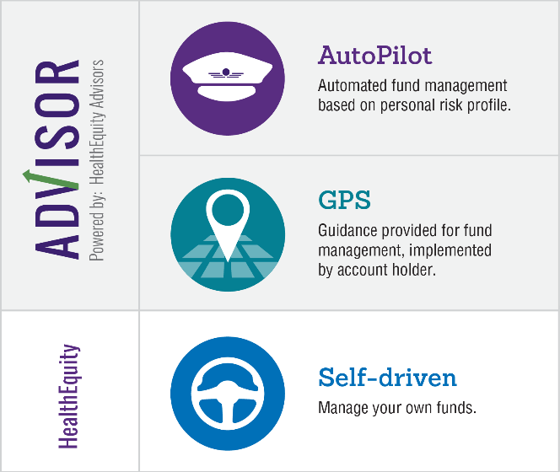
Options for investors of all confidence levels
Whether you’re ready to manage your own portfolio or need a little help – we provide access t tools to help you invest with confidence.
Investments are subject to risk, including the possible loss of the principal invested and are not FDIC or NCUA insured, or guaranteed by HealthEquity, Inc. HSA holders may select mutual funds for investment through the HealthEquity investment platform but HealthEquity, Inc. does not provide investment advice. HealthEquity Advisors, LLC, a wholly owned subsidiary of HealthEquity, Inc. and an SEC-registered investment adviser, provides web-based investment advice to HSA holders that subscribe for its services (minimum thresholds and additional fees apply). Registration does not imply endorsement by any state or agency and does not imply a level of skill, education, or training. Investing may not be suitable for everyone. You should carefully consider the investment objectives, risks, charges and expenses of any mutual fund before investing. A prospectus and, if available, a summary prospectus containing this and other important information can be obtained by visiting the fund sponsor’s website. Please read the prospectus carefully before investing.

Slide 22
Personalized Decision Support
Decision Doc helps you choose the right health plan for you and your family.

Slide 23
Why Use Decision Doc:
~$1,300 savings per employee
5-10 minutes to complete
All information is secure and confidential
Notes:
As an added benefit to you, we’re pleased to share that Decision Doc, powered by MyHealthMath, is available to all employees. MyHealthMath is a completely neutral third party and their interactive platform can help you learn about our health plan options before making your enrollment decision.
This is a free, quick, and easy confidential service that we encourage everyone to use. It can provide peace of mind for those of you that already know which plan you want to select. Alternatively, if you aren’t sure which plan you’re going to choose, Decision Doc can help you decide!

Slide 24
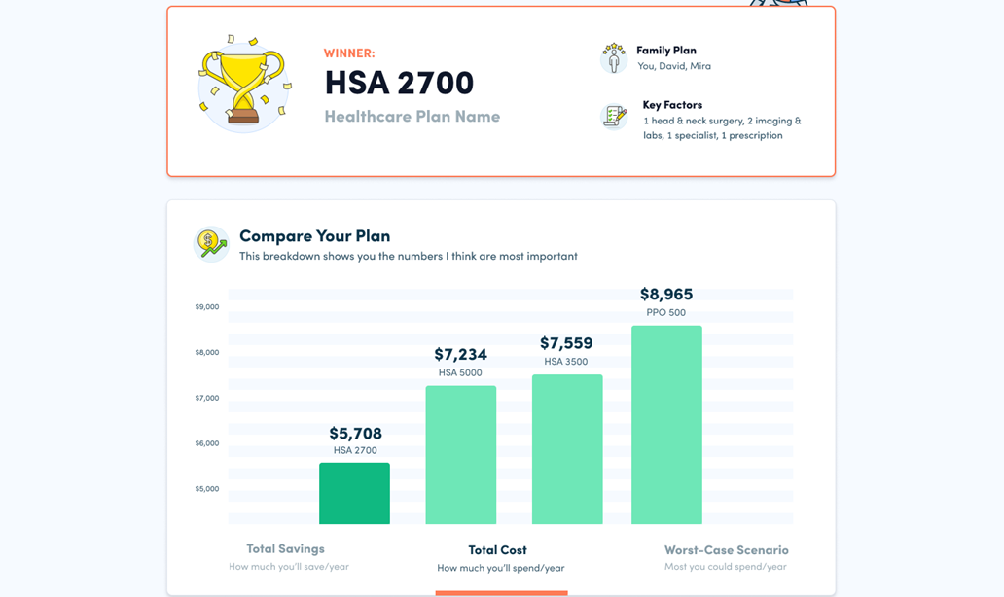
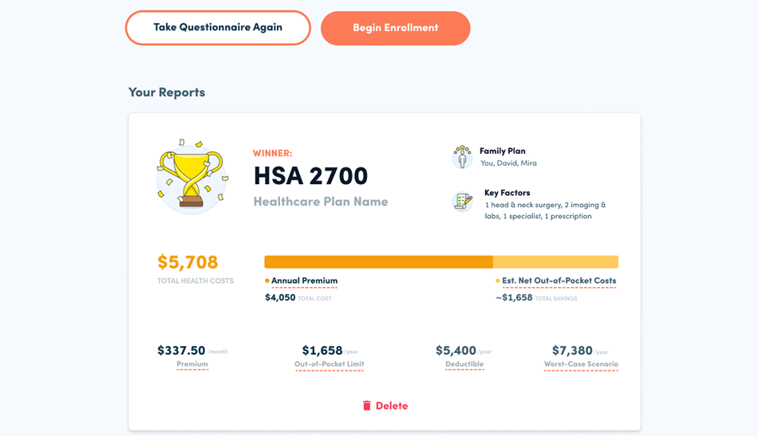
How It Works
Access Decision Doc here: www.myhealthmath.com/kingphilip2022
Share your medical and pharmacy needs in ~5 minutes
Agents available to go through the questions on the phone!
Receive immediate recommendations on optimal plan
Contact support with any questions!
Enroll & Save
Average employee user saves $1,300/year
1
2
3
Notes:
Decision Doc can be accessed using the link above, or by scanning the QR code.
You’ll start by answering some medical questions, either online or by scheduling a phone call. Questions range from the types of specialists you and your family members may see, to surgeries you may be thinking of, to the types of prescriptions anyone may be taking. This level of detail is important so Decision Doc can calculate which plan option will best meet your specific medical needs.
If you answer these questions online, you’ll receive an immediate recommendation on which plan will be the best fit, based on cost, for you and your family. Your report will include details on how Decision Doc determine your winning plan, as well as provide a bunch of resources to help you make your decision.
If you do decide to go through the questions over the phone with a MyHealthMath agent, you will receive your report via email within 1 – 2 business days.
At any time, we encourage you to connect with MyHealthMath if you have any questions about how to use Decision Doc or how to understand your report. They can be reached via questions@myhealthmath.com.

Slide 25
Dental
Altus Dental

Slide 26
Altus Dental No Plan Design Changes – No Change to Rates
Dental Plan Provisions | LOW PLAN |  | HIGH PLAN
Deductible | In-Network | Out-of-Network (90th) | In-Network | Out-of-Network (90th)
Individual | $50 |  | $50
Family | $150 |  | $150
Type One
Preventive | 100% | 100% | 100% | 100%
Diagnostic | 100% | 100% | 100% | 100%
Type Two
Restorative | 100% | 80% | 100% | 80%
Endodontic | 100% | 80% | 100% | 80%
Periodontics | 100% | 80% | 100% | 80%
Oral Surgery | 100% | 80% | 100% | 80%
Type Three
Major Restorative (Crowns) | N/A | N/A | 60% | 50%
Prosthodontics (Bridges, Dentures) | N/A | N/A | 60% | 50%
Calendar Year Maximum Benefit | $750 |  | $1,000
Orthodontia | N/A |  | 50%
Orthodontia Lifetime Maximum | N/A |  | $1,000
Rate Guarantee | 1 Year
Your Bi-Weekly Costs
 | Low Plan |  | High Plan
 | 21 Payroll Deductions | 26 Payroll Deductions | 21 Payroll Deductions | 26 Payroll Deductions
Single | $9.30 | $7.51 | $12.84 | $10.37
Family | $29.12 | $23.52 | $39.17 | $31.63

Slide 27
Vision
VSP

Slide 28
VSP Voluntary Vision Plan No Plan Design Changes – No Change to Rates
 | In-Network | Out-of-Network
Exams
Exam | $10 Copay | Up to $45
Frequency | 12 months
Lenses
Single Vision | $25 Copay | Up to $30
Lined Bifocal | $25 Copay | Up to $50
Lined Trifocal | $25 Copay | Up to $65
Lenticular | $25 Copay | Up to $100
Frequency | 12 months
Frames (in lieu of contacts)
Benefit | $130 Allowance - 20% Discount on Remaining Balance | Up to $70
Frequency | 24 months
Elective Contact Lenses
Benefit | $130 Allowance - Up to $60 Contact Lens Fitting Copay | Up to $105
Frequency | 12 months
Necessary Contact Lenses
Benefit | $210 Allowance - Up to $60 Contact Lens Fitting Copay | Up to $210
Frequency | 12 months
 | Bi-Weekly Rates
 | 21 Payroll Deductions |  | 26 Payroll Deductions
Individual | $3.77 |  | $3.04
Family | $8.09 |  | $6.54

Slide 29
Health & Wellbeing Offerings

Slide 30
2021-22 Calendar of Events
Annual
Monthly

Slide 31
Fitness Reimbursement
Two members in a family plan can now submit for reimbursement for a total of $300
Pay your monthly fees
Membership or virtual fitness subscription
After four months either
Submit your request online
Complete the paper form
You can submit your request starting May 1, 2022

